Slide 1
Predicting and Clustering Bird Migration Patterns Across Americas
Team: Yangkang Chen, Dean Lawrence

Slide 2
Team Plan
Task | Summary | Deadline | Yangkang | Dean
Data exploration | Visually explore qualities of dataset | Feb. 3 | X | X
Apply gridding algorithm | Implement stixel generation algorithm from AdaSTEM paper | Feb. 7 | X
Supervised learning | Apply a variety of supervised learning models to the gridded data | Feb. 14 | X | X
Prediction | Create and evaluate predictions based on supervised learning models | Feb. 18 | X | X
Unsupervised learning | Perform unsupervised learning to extract insights from predictions made by unsupervised learning models | Feb. 24 |  | X
Standups | Prepare materials to show at standups based on work completed prior to the meeting | Feb. 7, Feb. 21 | X | X
Report drafting | Complete writing of final report | Feb. 28 | X | X

Slide 3
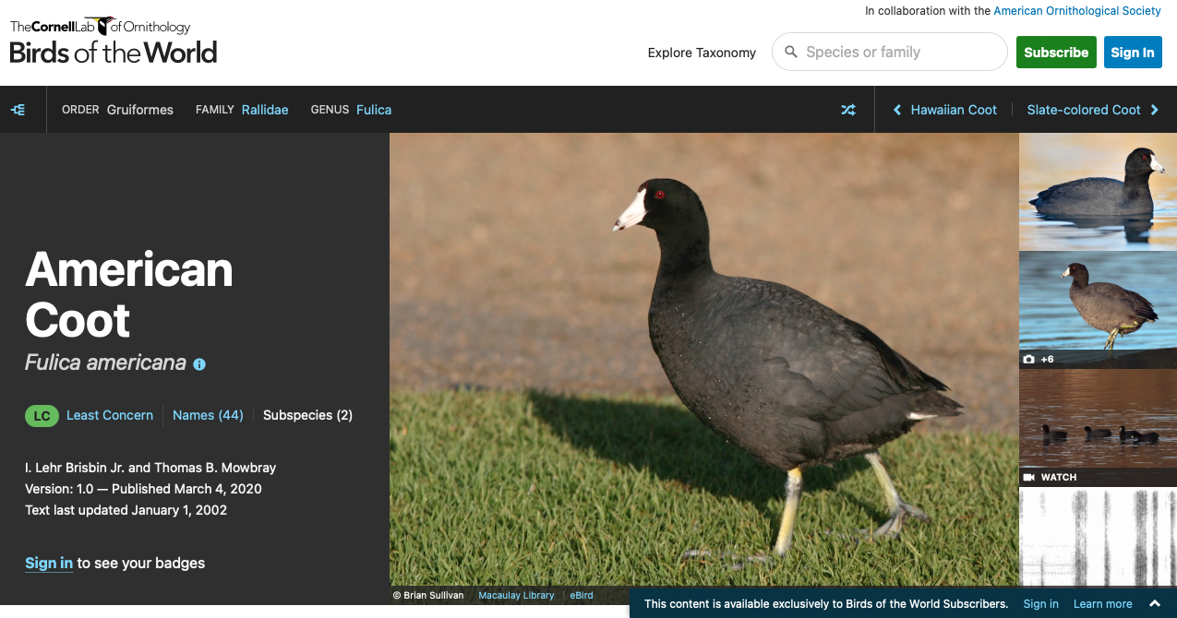
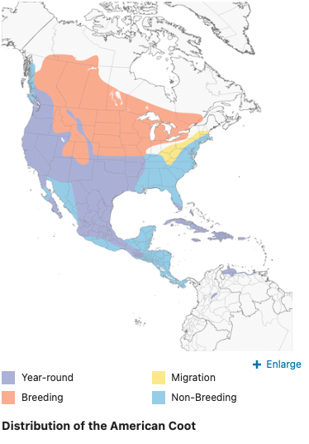
https://birdsoftheworld.org/bow/species/y00475/cur/introduction

Slide 4
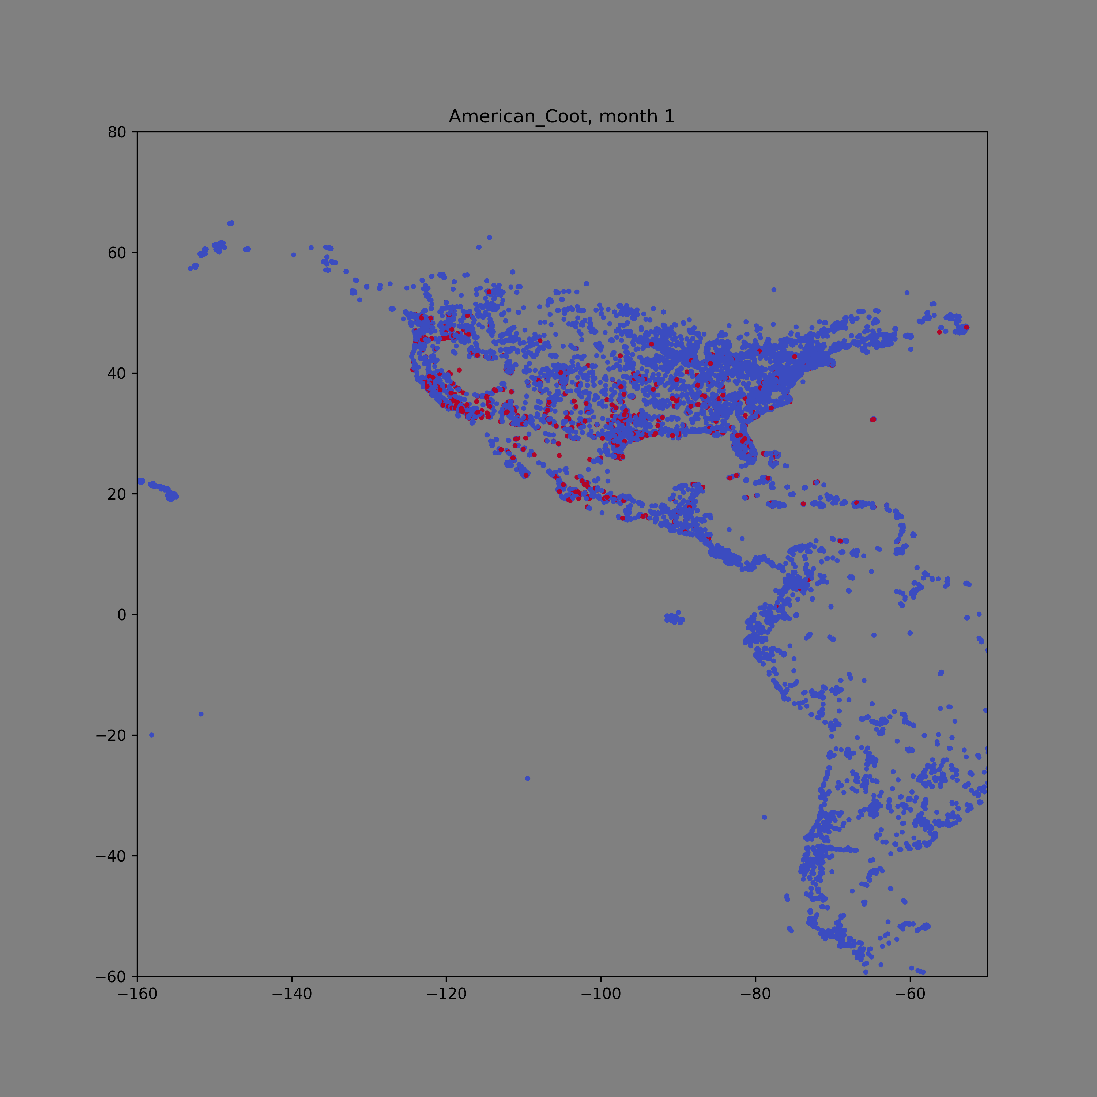

Slide 5
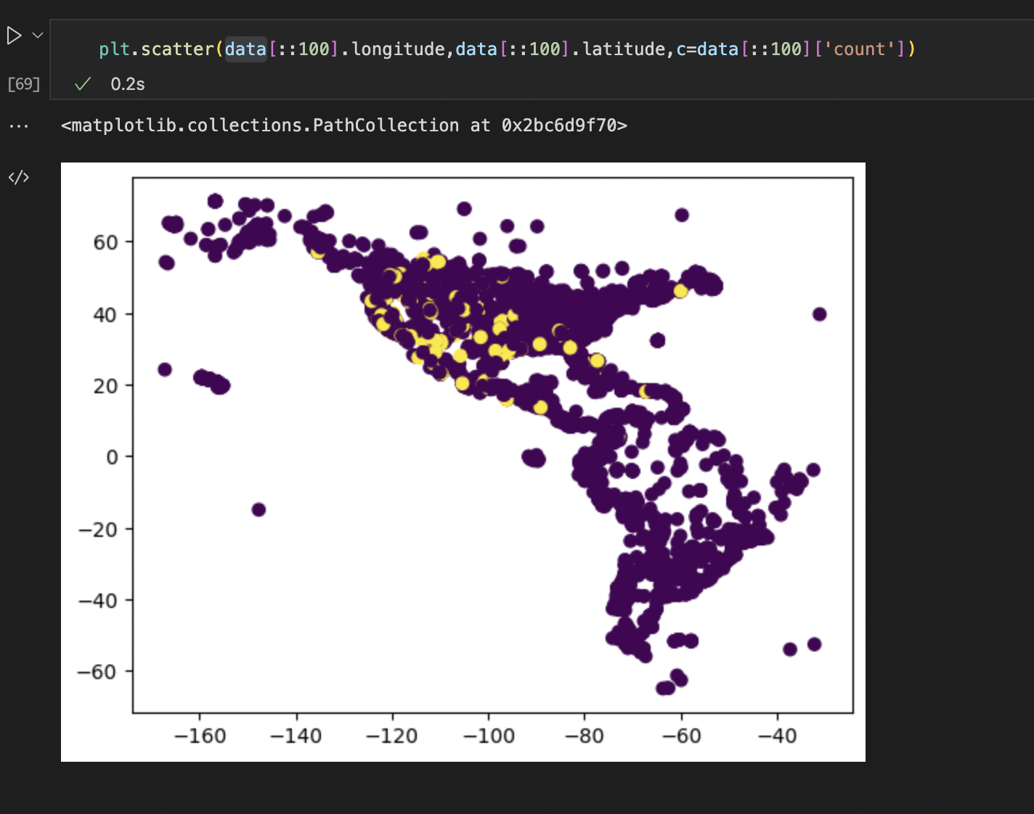
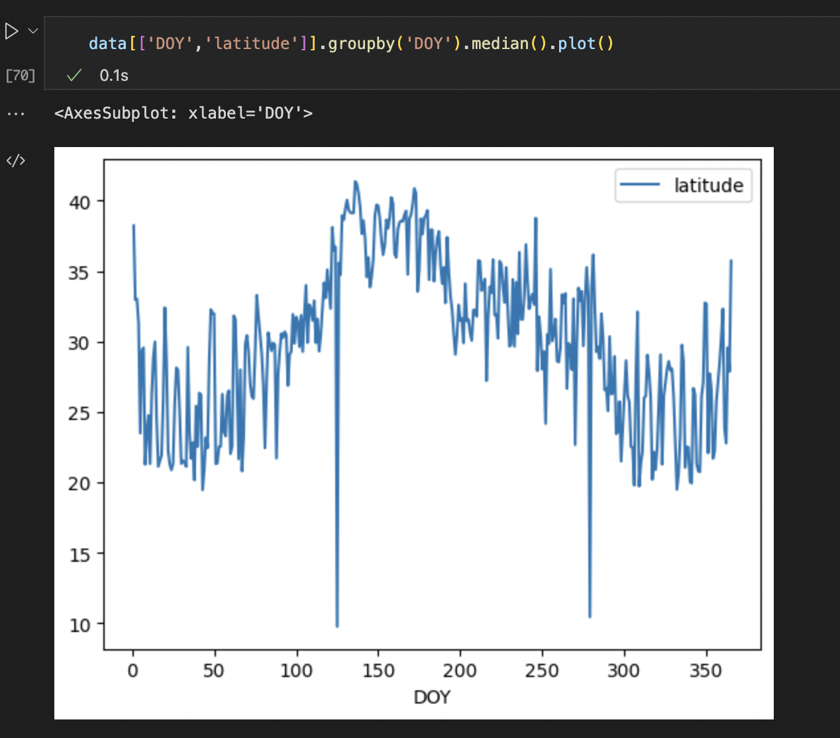

Slide 6
Data
No gridding
Gridding
Predict (adjust observation bias)
Reduce data volumn &
dimension
Supervised learning
Supervised learning
Clustering different species’ migration pattern
ensemble
evaluation
evaluation

Slide 7
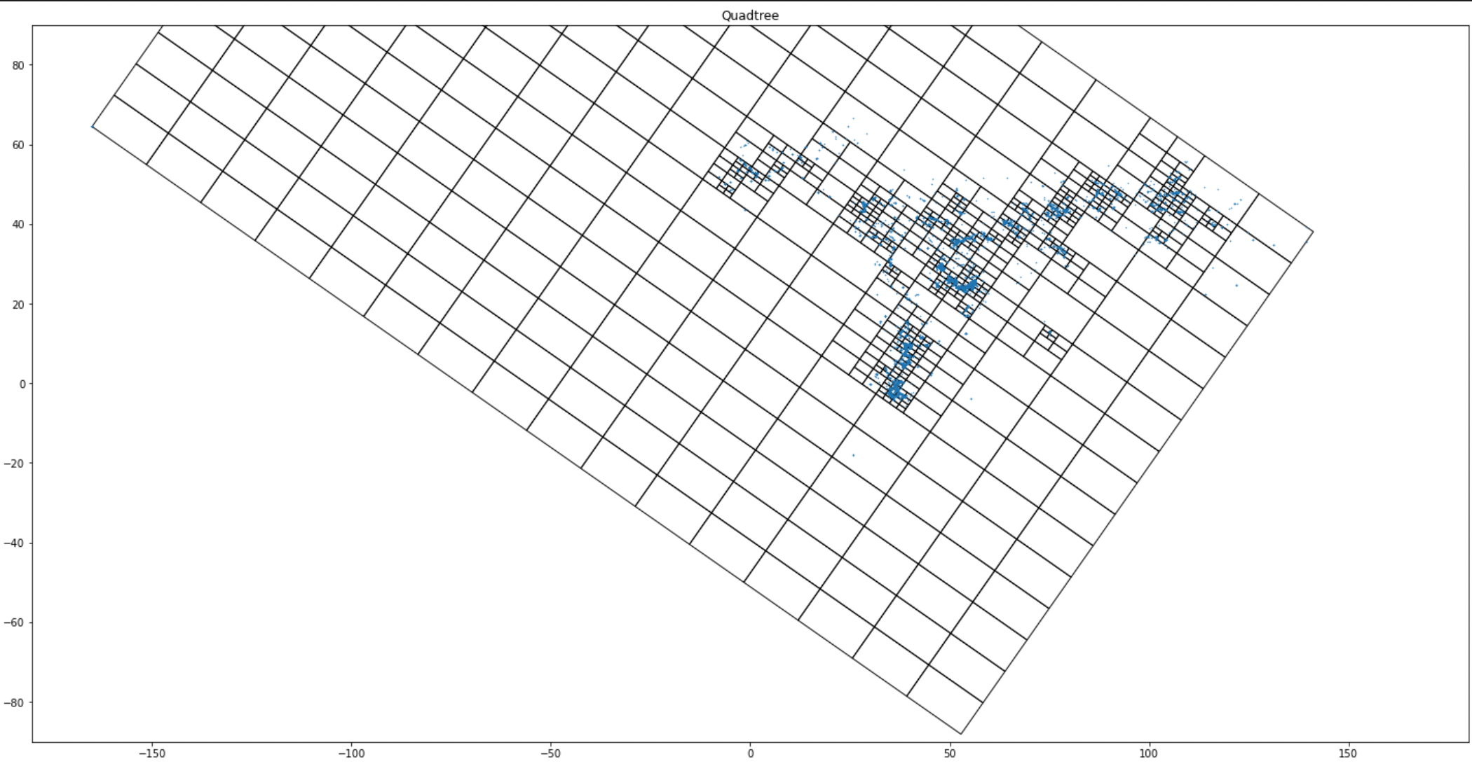
QuadTree implementation
100 spatial ensembles
Thousands of stixels for each ensembles
(spatial temporal pixel)
One base learning model for each stixel

Slide 8
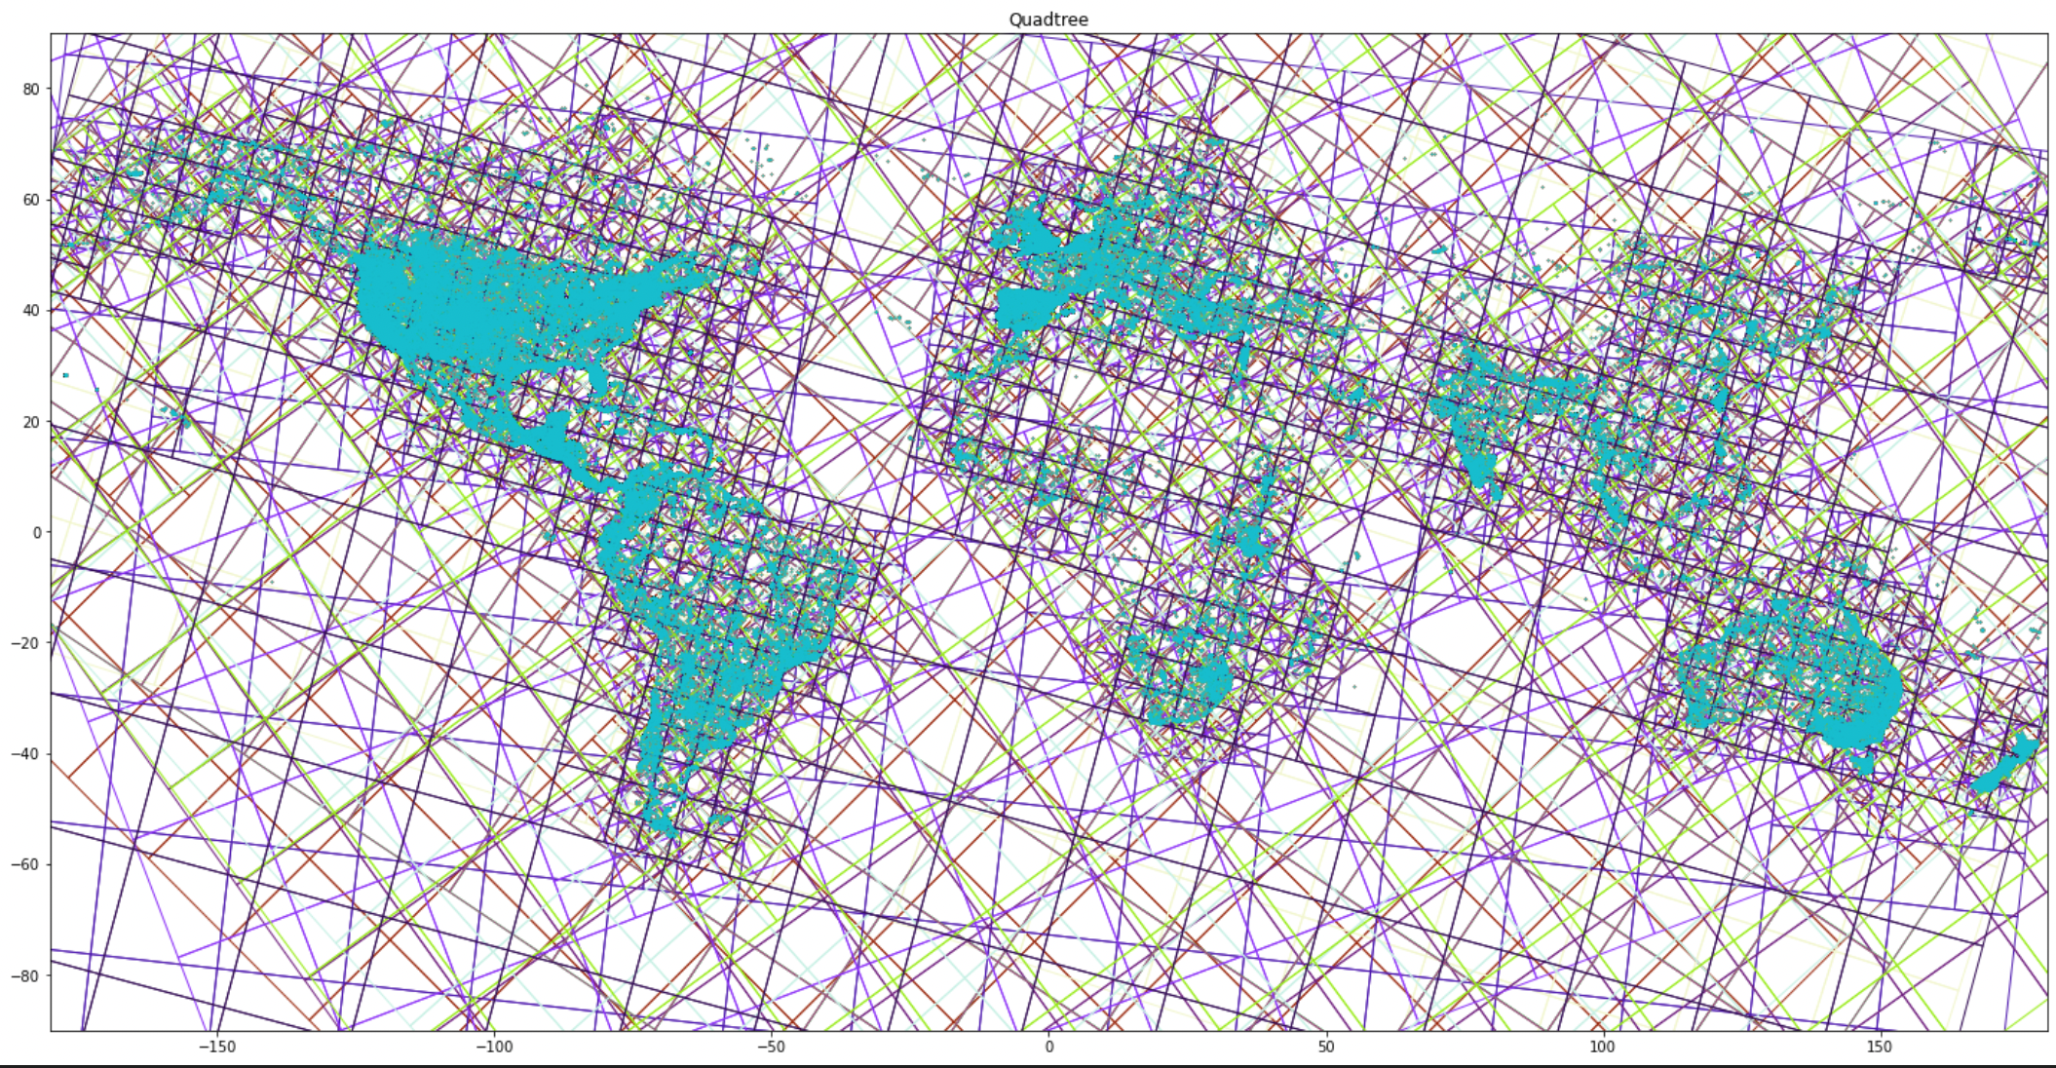
QuadTree implementation
100 spatial ensembles
Thousands of stixels for each ensembles
(spatial temporal pixel)
One base learning model for each stixel

Slide 9
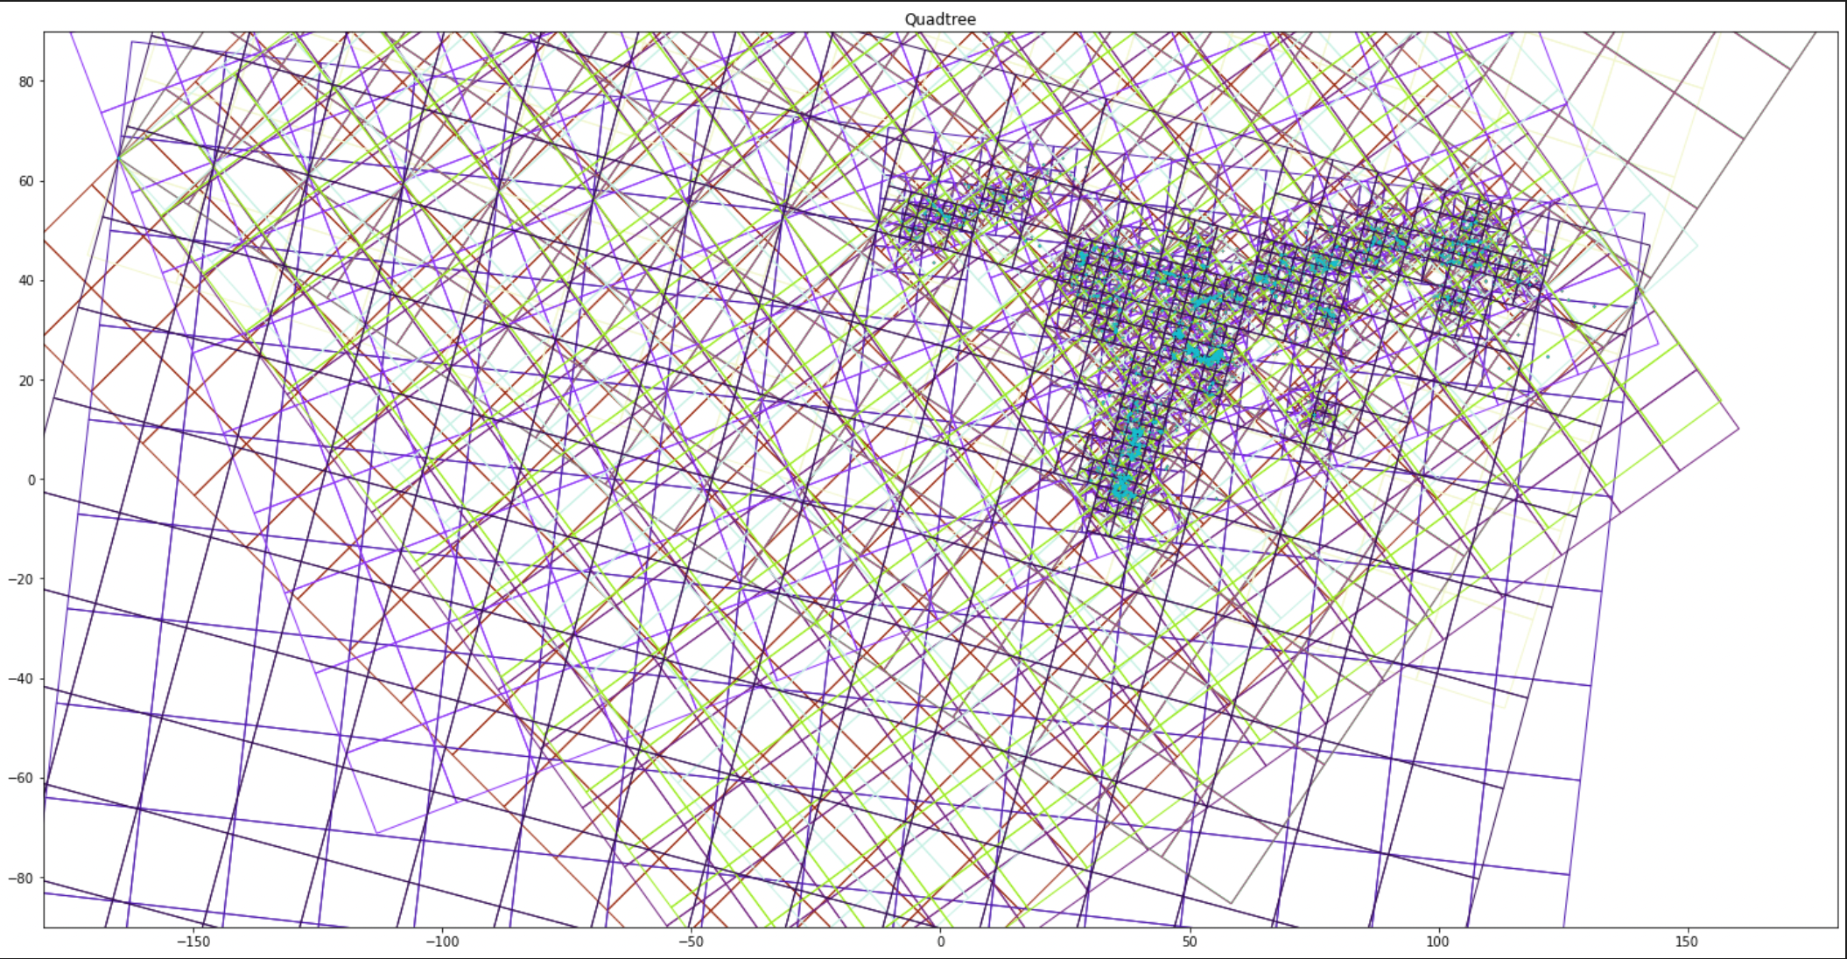
Training data
Gridding
New data
Predict
grid1
grid2
grid3
grid4
…
Supervised ML model
Supervised ML model
Supervised ML model
Combine back.
Take the average across ensambles.
Training

Slide 10
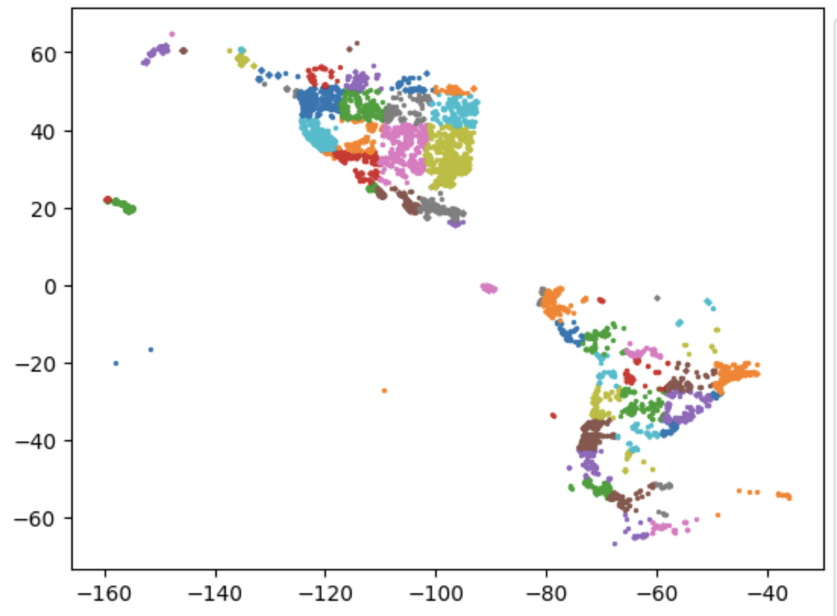
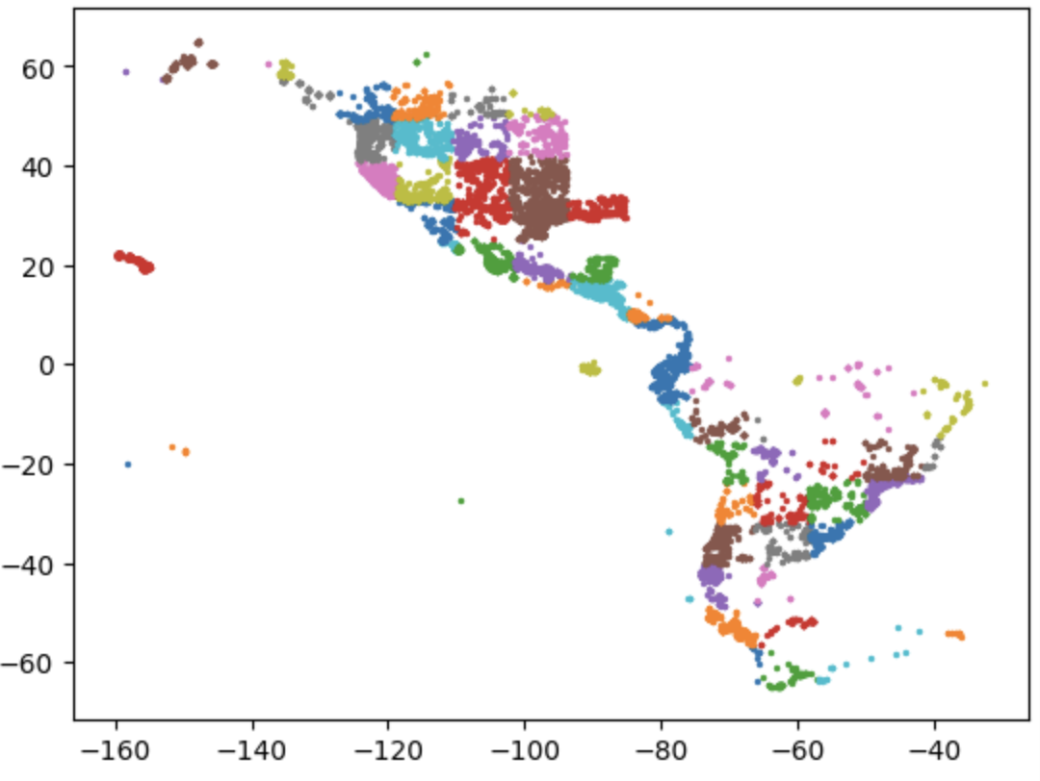
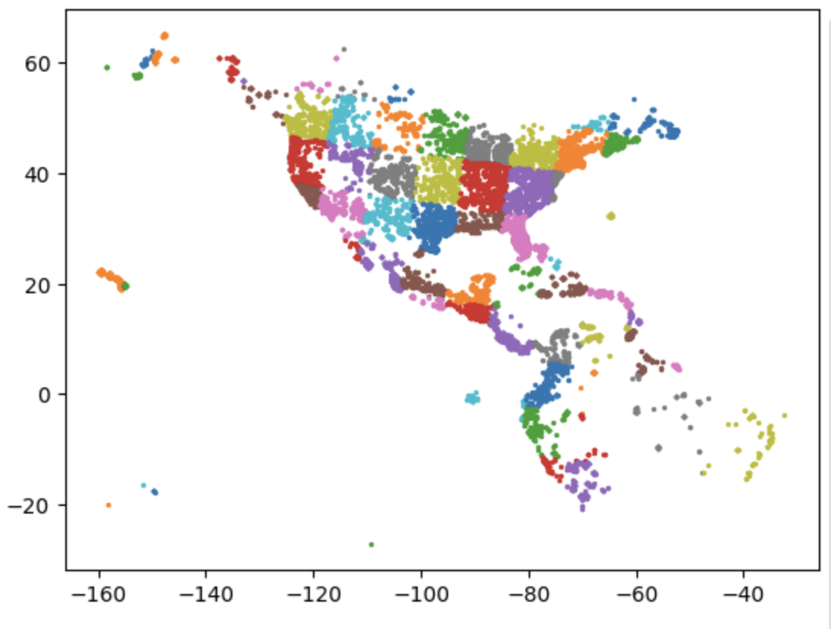
3 ensembles as an example

Slide 11
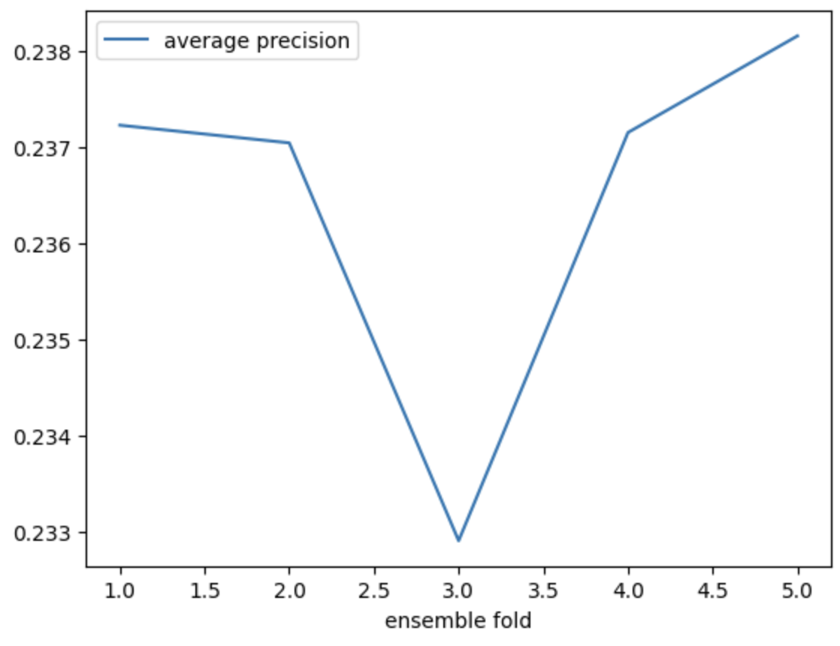
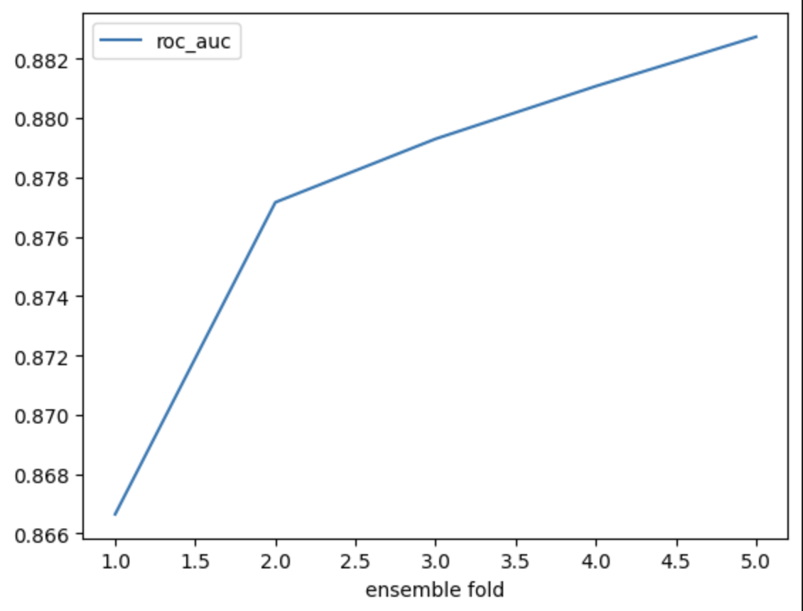
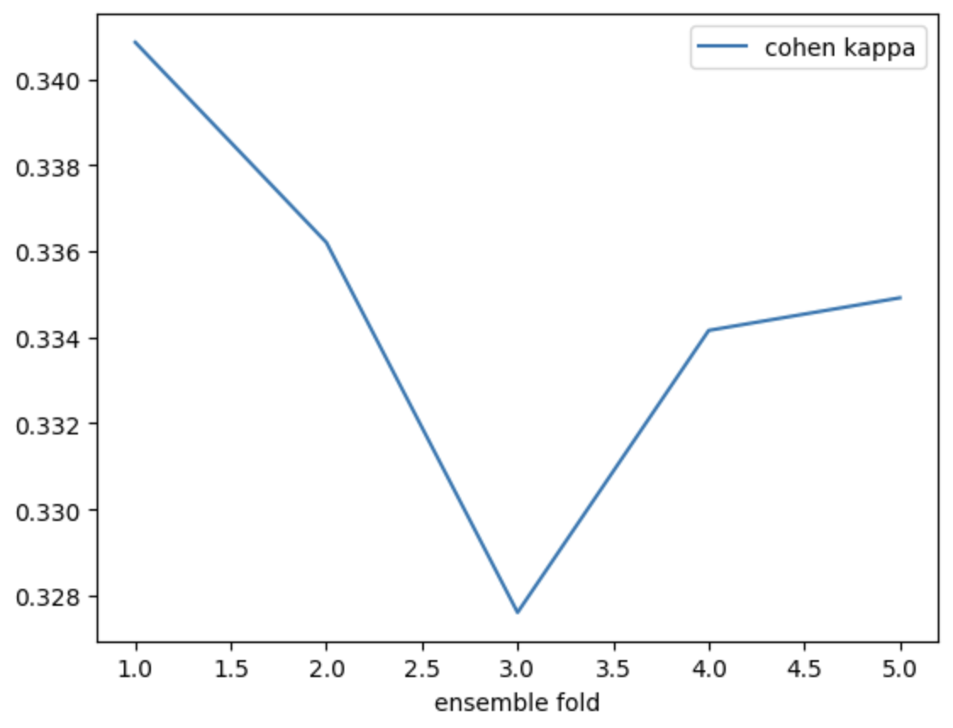
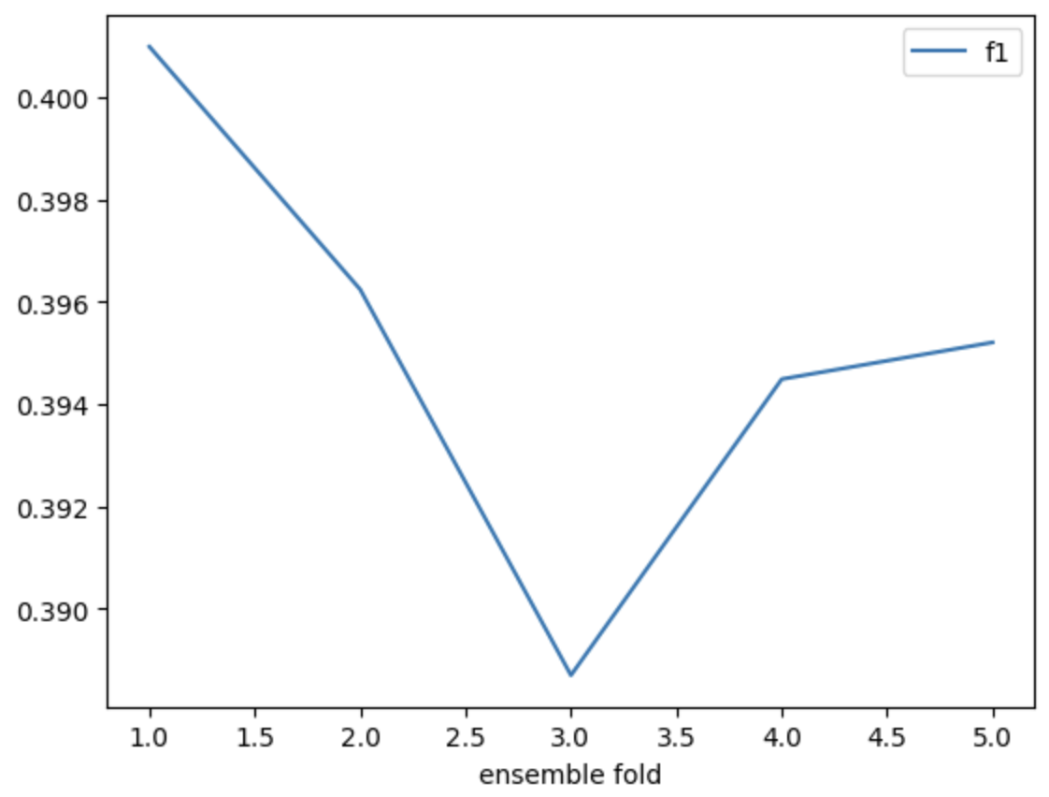
ROC-AUC score increase with ensemble fold

Slide 12
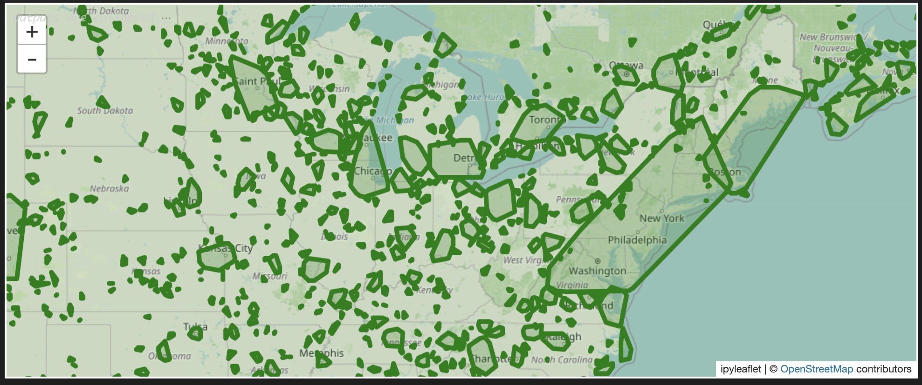

Slide 13
Location | Time | Sp1 | Sp2 | Sp3 | Sp4
(or longitude, latitude) | (date) | 1 | 1 | 0 | 1
 |  | 1 | 0 | 1 | 0
 |  | 0 | 1 | 1 | 1
 |  | 1 | 0 | 1 | 1
 |  | 0 | 1 | 0 | 1

Slide 14
Next week
Finish and summarize supervised learning part
Solve the unsupervised learning part

